Slide 1

Explaining Explainable AI (XAI)
Nicklas Ankarstad
Sr. Manager, Adv. Analytics & BI
Alliant Credit Union

Slide 2
Problem Definition
01
Overview of Explainability
02
Modelling and Explainability Techniques
03
How to determine when to use what

Slide 3
Overview of Explainability
Explainable AI refers to methods and techniques in the application of artificial intelligence technology (AI) such that the results of the solution can be understood by human experts.
It contrasts with the concept of the "black box" in machine learning where even their designers cannot explain why the AI arrived at a specific decision. XAI is an implementation of the social right to explanation
3

Slide 4

Why Explainability Matters in Financial Services
Trust
Transparency
Unintentional Bias
Adoption
4

Slide 5
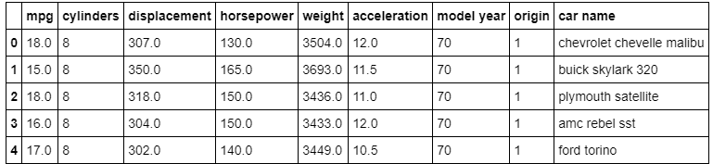
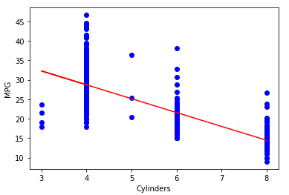
Linear Regression Example
Formula
y = -3.56x +42.95
5

Slide 6
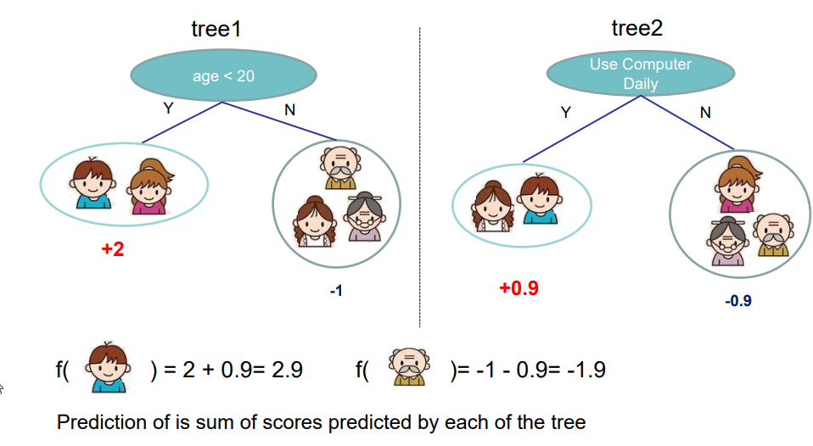
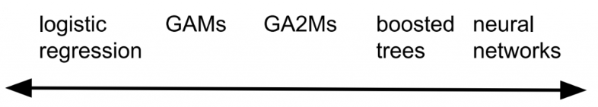
Increasing Performance through Complexity
XGBoost, H2O, LightGBM, AdaBoost & Catboost
Consistently wins data science competitions for tabular data
Converts weak learners (decision trees) into strong learners
Lower bias & lower variance by using boosting

Slide 7
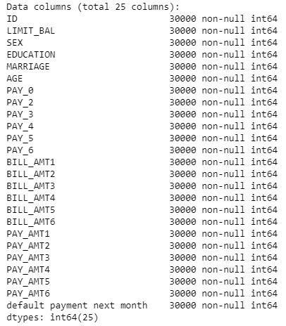
More Complex Problem
UCI has a credit card default dataset from a Taiwanese bank
The columns include information on each borrowers:
Demographics
Historical repayment history
Historical bill amount
Historical previous payment amount
We are interested in predicting next payment default using XGBoost

Slide 8
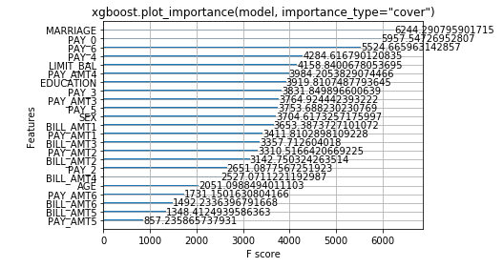
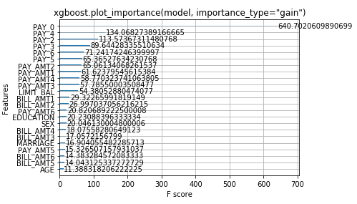
Feature Importance

Slide 9
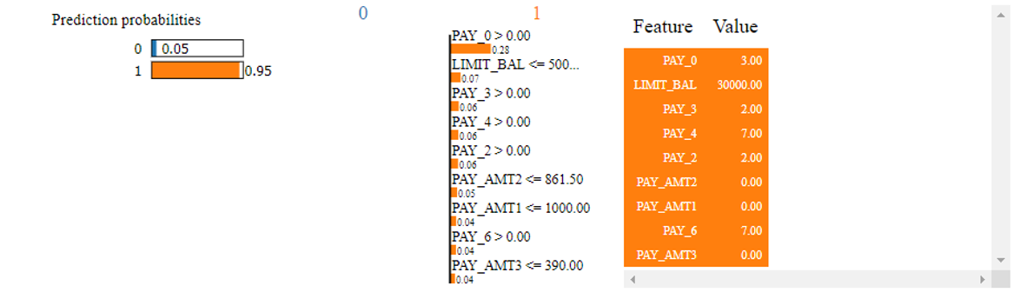
LIME Local Importance
LIME, an algorithm that can explain the predictions of any classifier or regressor in a faithful way, by approximating it locally with an interpretable model
LIME is locally faithful, but not globally accurate

Slide 10
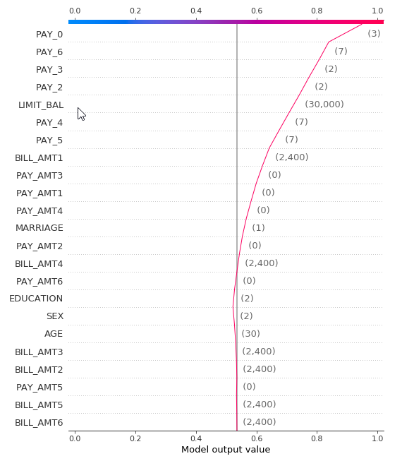
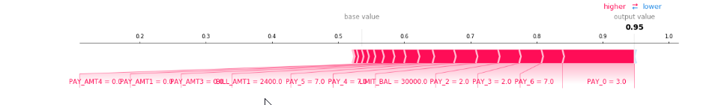
SHAP Local Importance
SHAP (SHapley Additive exPlanations) is a game theoretic approach to explain the output of any machine learning model.
It connects optimal credit allocation with local explanations using the classic Shapley values from game theory and their related extensions.

Slide 11
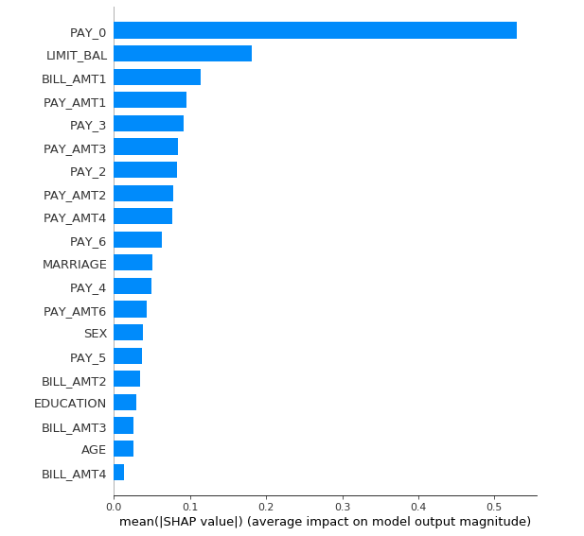
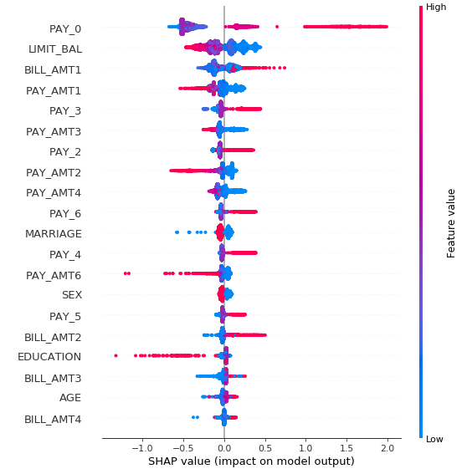
SHAP Global Importance
SHAP global importance is consistent with its local importance since its an aggregation of local importance.
It’s also very accurate for tree-based models

Slide 12
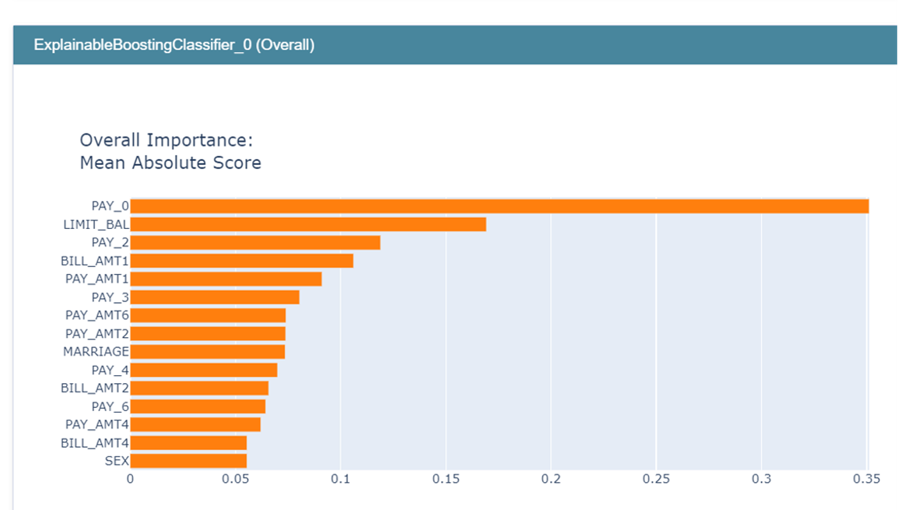
InterpretML Explainable Boosting Machine
EBM uses modern machine learning techniques like bagging and boosting to breathe new life into traditional GAMs (Generalized Additive Models).
This makes them as accurate as random forests and gradient boosted trees, and also enhances their intelligibility and editability

Slide 13
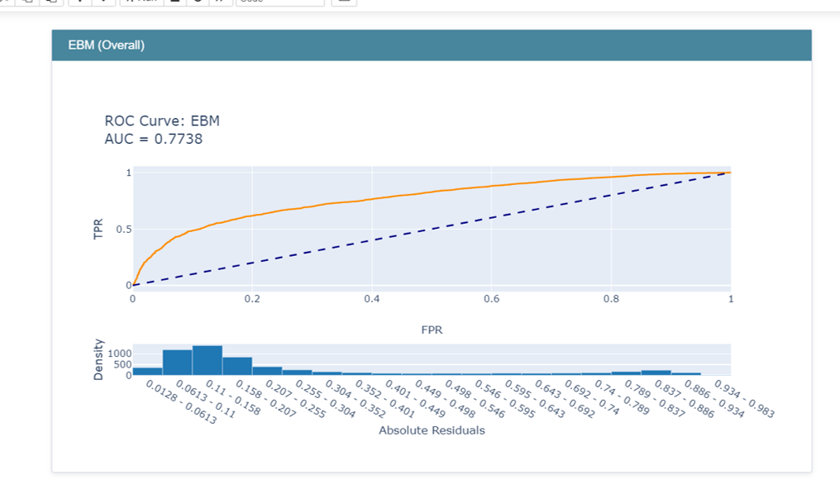
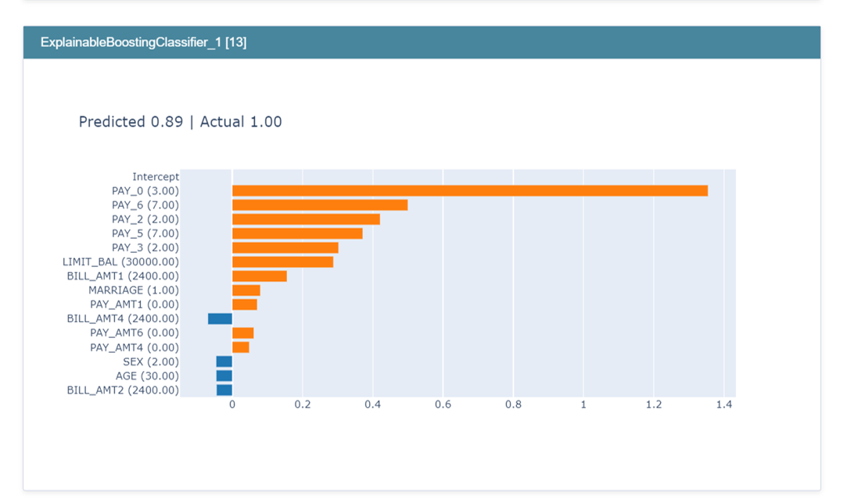
EBM Dashboard

Slide 14
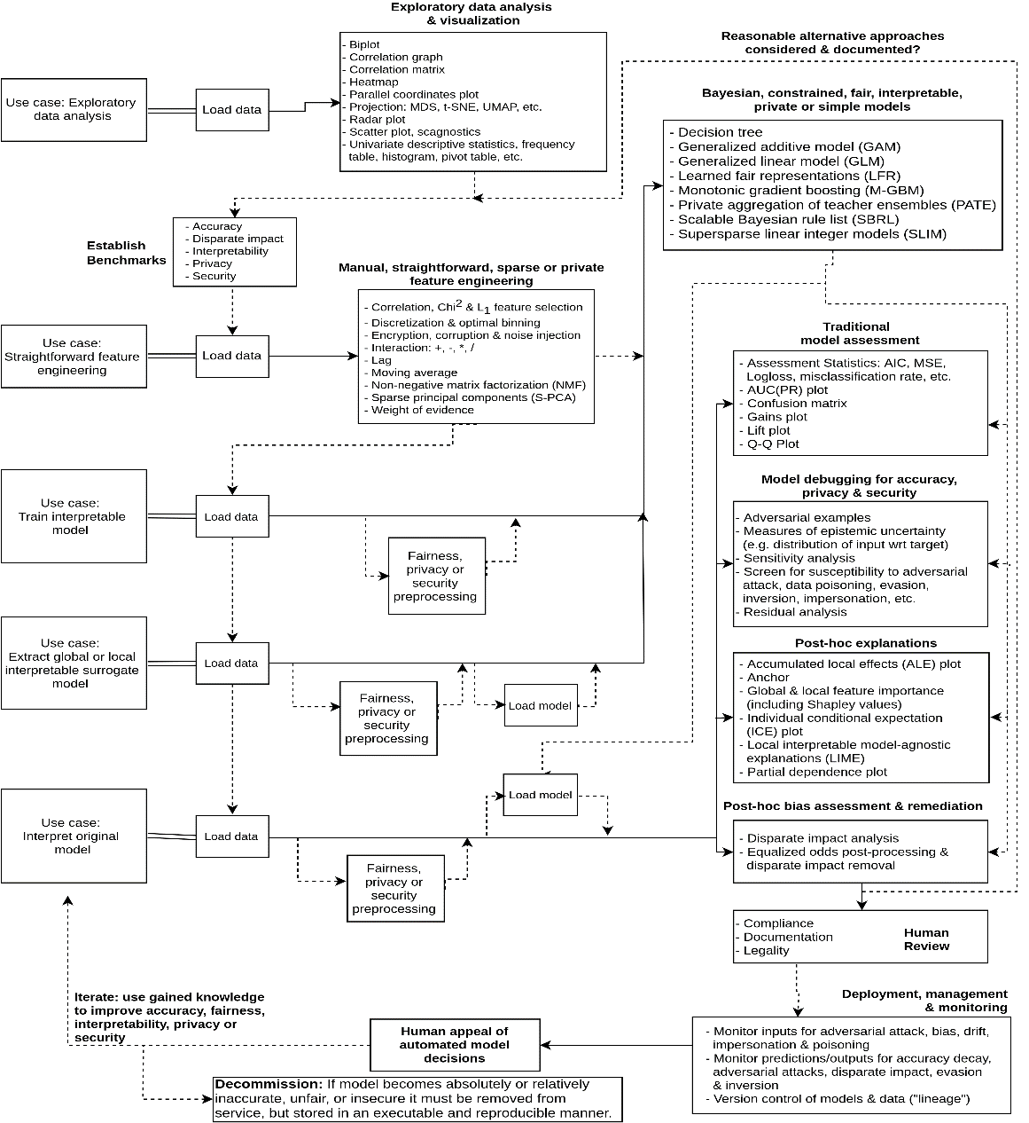
When to use what?
Build trust with your stakeholders by being transparent in modeling
If you are a decision maker, always ask your data scientist or vendor for explanations of how the model makes decisions
As with almost everything in life, the best model and explanations option usually depends on the situation
To be better prepared for the situations, its good to use a framework, like the one developed by Patrick Hall from H20.ai

Slide 15

LinkedIn: Nicklas Ankarstad
nankarstad@alliantcreditunion.com
Thank you
(773) 462-8655
Notebooks and code available on GitHub
https://github.com/nirr3/CULytics2020

